Slide 1


Bangladesh Army University of Engineering & Technology
Chapter: Cryptographic Techniques
Lecture-01
Mehedi Hasan Imran
Lecturer, BAUET
Dept. of ICE

Slide 2
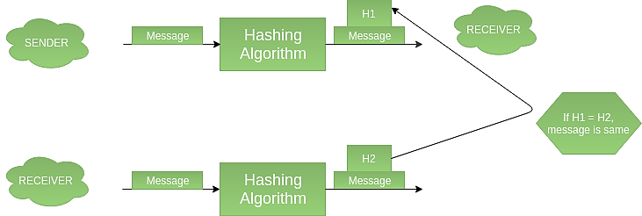
Hashing
Hashing: It involves taking the plain text and converting it to a hash value of fixed size by a hash function. This process ensures the integrity of the message as the hash value on both, the sender’s and receiver’s sides should match if the message is unaltered.

Slide 3
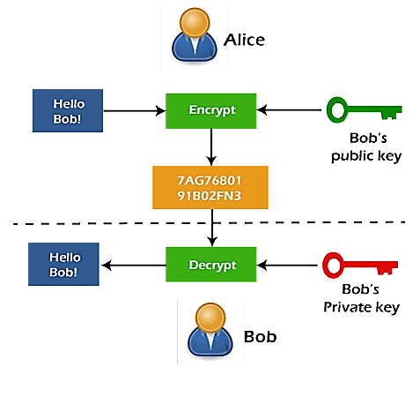
Encryption

Slide 4
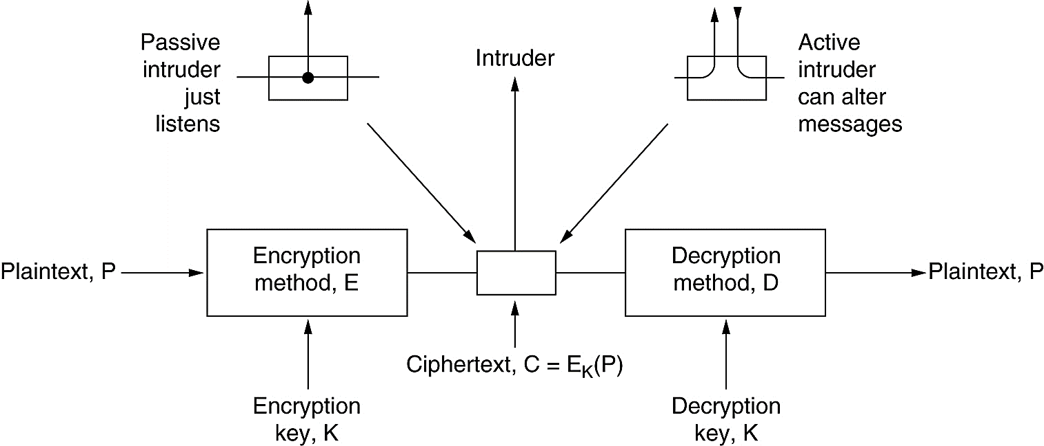
The encryption model (for a symmetric-key cipher)

Slide 5
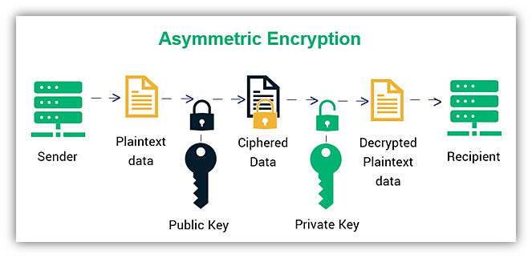
The encryption model (for a Asymmetric-key cipher)

Slide 6
Classical Encryption Technique
Substitution Technique
Caesar Cipher
Monoalphabetic Cipher
Transposition Technique
Rail Fence
Row Column Transposition
Playfair Cipher
Hill Cipher
Polyalphabetic Cipher
One-Time Pad

Slide 7
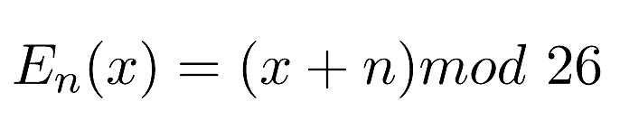
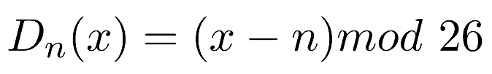
Caesar Cipher in Cryptography
The Caesar Cipher technique is one of the earliest and simplest methods of encryption technique. It’s simply a type of substitution cipher, i.e., each letter of a given text is replaced by a letter with a fixed number of positions down the alphabet. For example with a shift of 1, A would be replaced by B, B would become C, and so on. The method is apparently named after Julius Caesar, who apparently used it to communicate with his officials.
Thus to cipher a given text we need an integer value, known as a shift which indicates the number of positions each letter of the text has been moved down.
The encryption can be represented using modular arithmetic by first transforming the letters into numbers, according to the scheme, A = 0, B = 1,…, Z = 25. Encryption of a letter by a shift n can be described mathematically as.
(Encryption Phase with shift n)
(Decryption Phase with shift n)

Slide 8
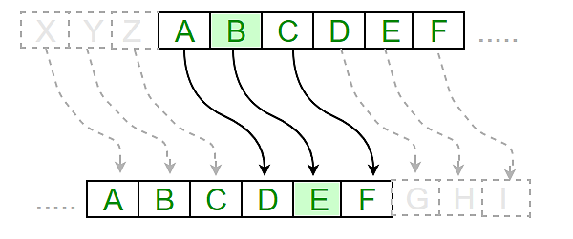
Caesar Cipher in Cryptography

Slide 9
Caesar Cipher in Cryptography
Examples :
Text : ABCDEFGHIJKLMNOPQRSTUVWXYZ
Shift: 23
Cipher: XYZABCDEFGHIJKLMNOPQRSTUVW
Text : ATTACKATONCE
Shift: 4
Cipher: EXXEGOEXSRGI

Slide 10
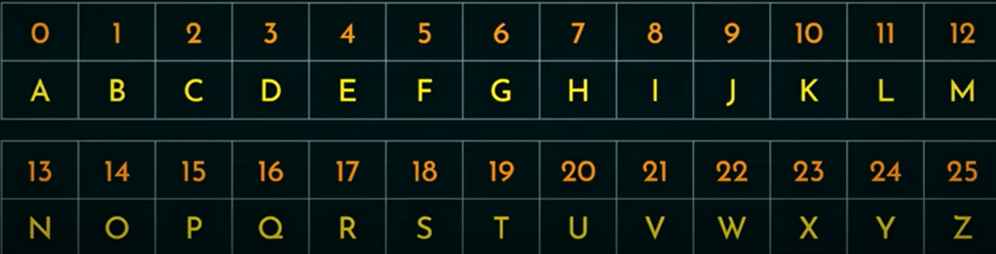
Monoalphabetic Substitution Ciphers
A monoalphabetic substitution cipher, also known as a simple substitution cipher, relies on a fixed replacement structure. That is, the substitution is fixed for each letter of the alphabet. Thus, if "a" is encrypted to "R", then every time we see the letter "a" in the plaintext, we replace it with the letter "R" in the ciphertext.
I B
R C
A F
M K
This will be the same for all

Slide 11
Playfair Cipher
Aka Playfair square or Wheatstone-Playfair cipher.
Manual symmetric encryption technique.
The first literal diagram substitution cipher.
Invented in 1854 by Charles Wheatstone.
Bore the name of Lord Playfair for promoting its use.

Slide 12
Playfair Cipher
Multiple letter encryption cipher.
Diagrams.
5 x 5 matrix constructed using a keyword (Ex: Monarchy).
M | O | N | A | R
C | H | Y | B | D
E | F | G | I/J | K
L | P | Q | S | T
U | V | W | X | Z

Slide 13
Rules for encryption using Playfair Cipher
Diagrams.
2. Repeating Letters - Filler letter.
3.Same Column | | Wrap around.
4. Same row | | Wrap around.
5. Rectangle | | Swap
M | O | N | A | R
C | H | Y | B | D
E | F | G | I/J | K
L | P | Q | S | T
U | V | W | X | Z

Slide 14
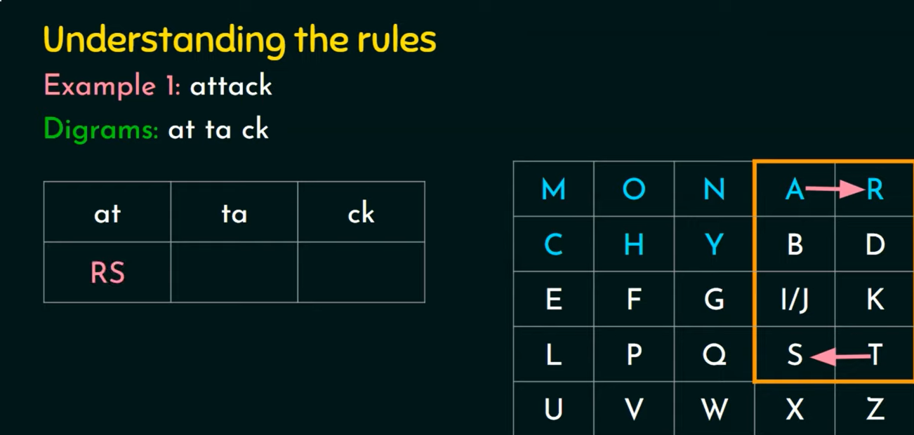
Rules for encryption using Playfair Cipher

Slide 15
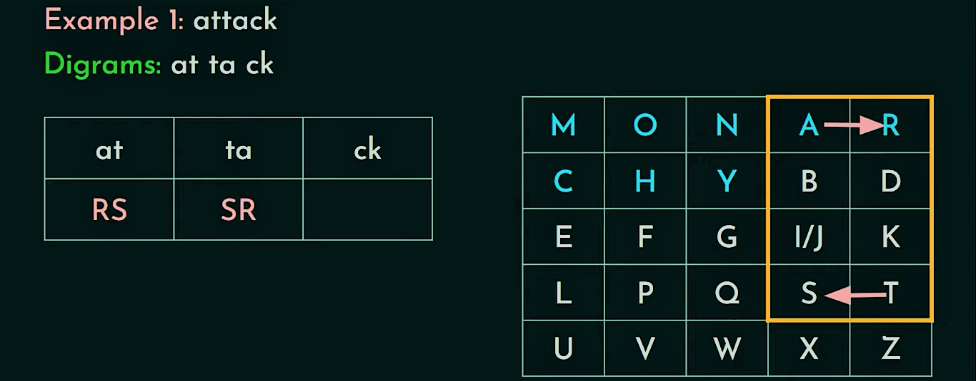
Rules for encryption using Playfair Cipher

Slide 16
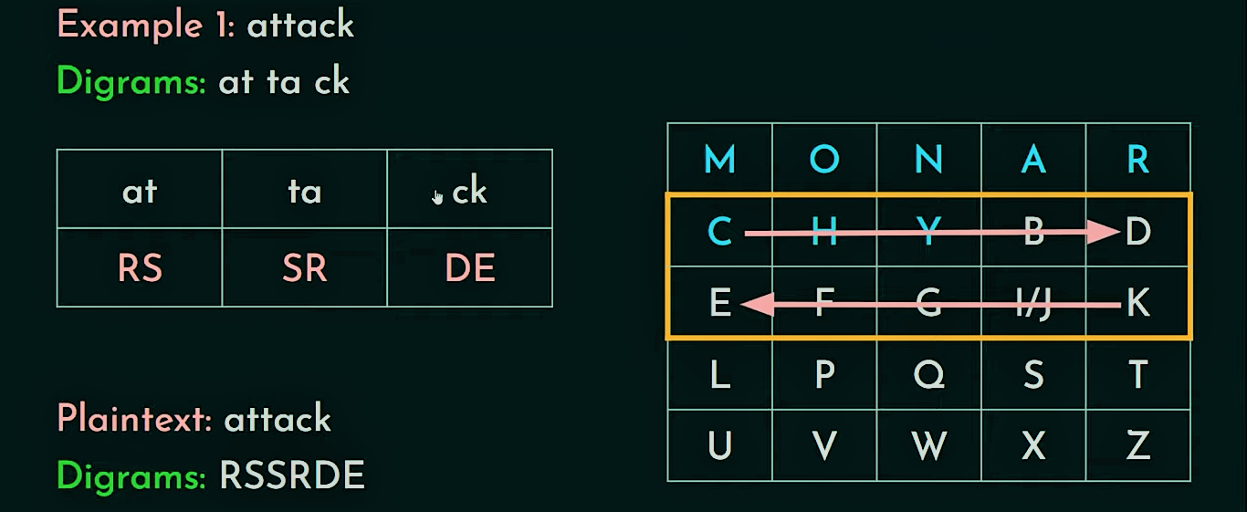
Rules for encryption using Playfair Cipher

Slide 17
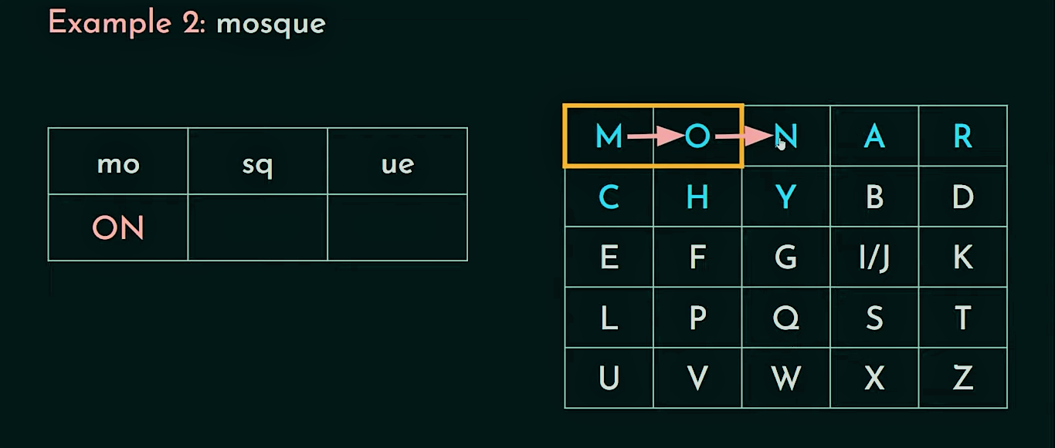
Rules for encryption using Playfair Cipher

Slide 18
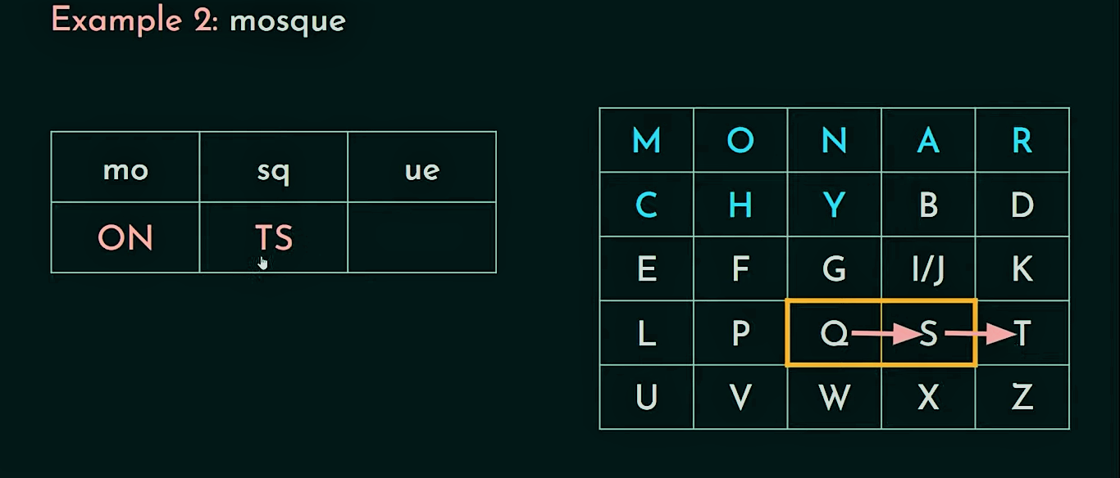
Rules for encryption using Playfair Cipher

Slide 19
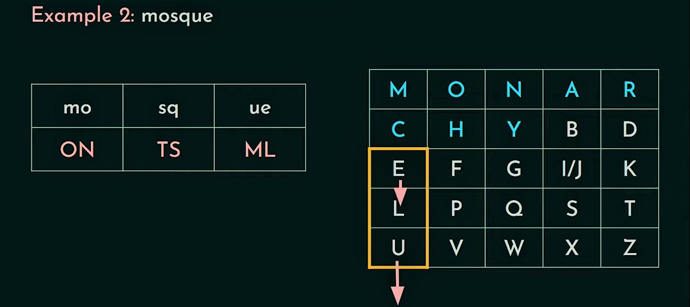
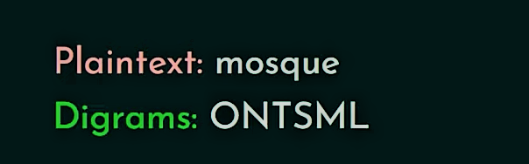
Rules for encryption using Playfair Cipher

Slide 20
Transposition Ciphers
A more complex scheme.
Rectangle.
Write: Row by Row.
Read: Column by Column.
Key: Order of the Column.
I M R A N
2 3 5 1 4
I | N | F | O | R
M | A | T | I | O
N | A | N | D | C
O | M | M | U | N
I | C | A | T | I
O | N | X | Y | Z
Plaintext: Information and Communication
Key: IMRAN
Cipher Text: OIDUTY IMNOIO NAAMCN ROCNIZ FTNMAX

Slide 21
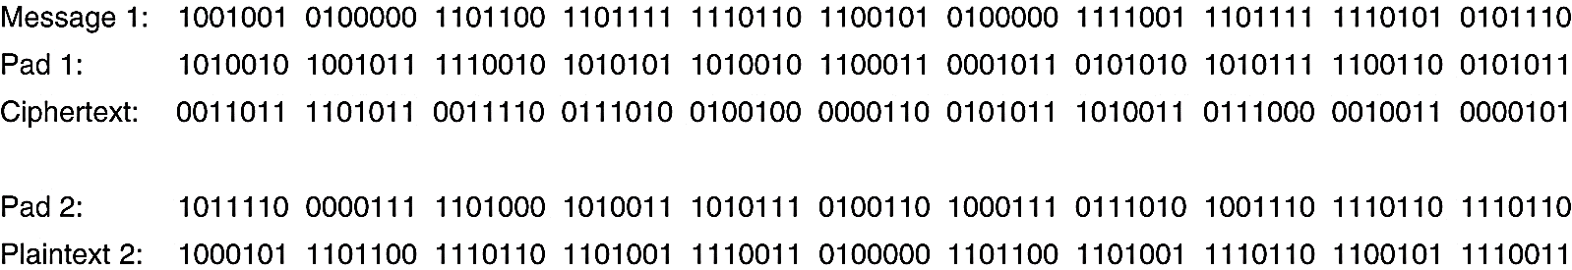
One-Time Pads
One-time pad cipher includes the following features −
It is an unbreakable cipher.
The key is exactly same as the length of message which is encrypted.
The key is made up of random symbols.
As the name suggests, key is used one time only and never used again for any other message to be encrypted.
XOR operation (If the number of 1 is odd then result will be 1 otherwise 0).

Slide 22
Rail Fence Cipher
Encryption
In the rail fence cipher, the plain-text is written downwards and diagonally on successive rails of an imaginary fence.
When we reach the bottom rail, we traverse upwards moving diagonally, after reaching the top rail, the direction is changed again. Thus the alphabets of the message are written in a zig-zag manner.
After each alphabet has been written, the individual rows are combined to obtain the cipher-text.
Plain Text: IMRAN
Depth/key: 3
Cipher Text: INMAR
I |  |  |  | N
 | M |  | A
 |  | R

Slide 23
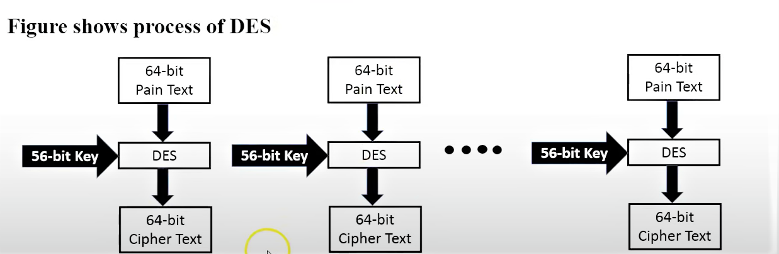
Data Encryption Standard
Block A
Block B
Block C

Slide 24
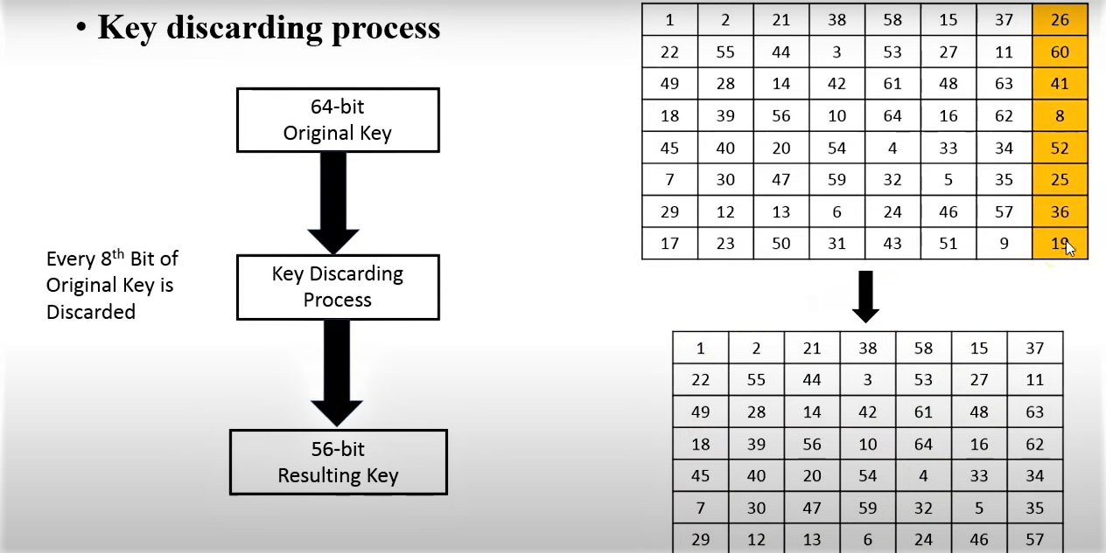
Data Encryption Standard

Slide 25
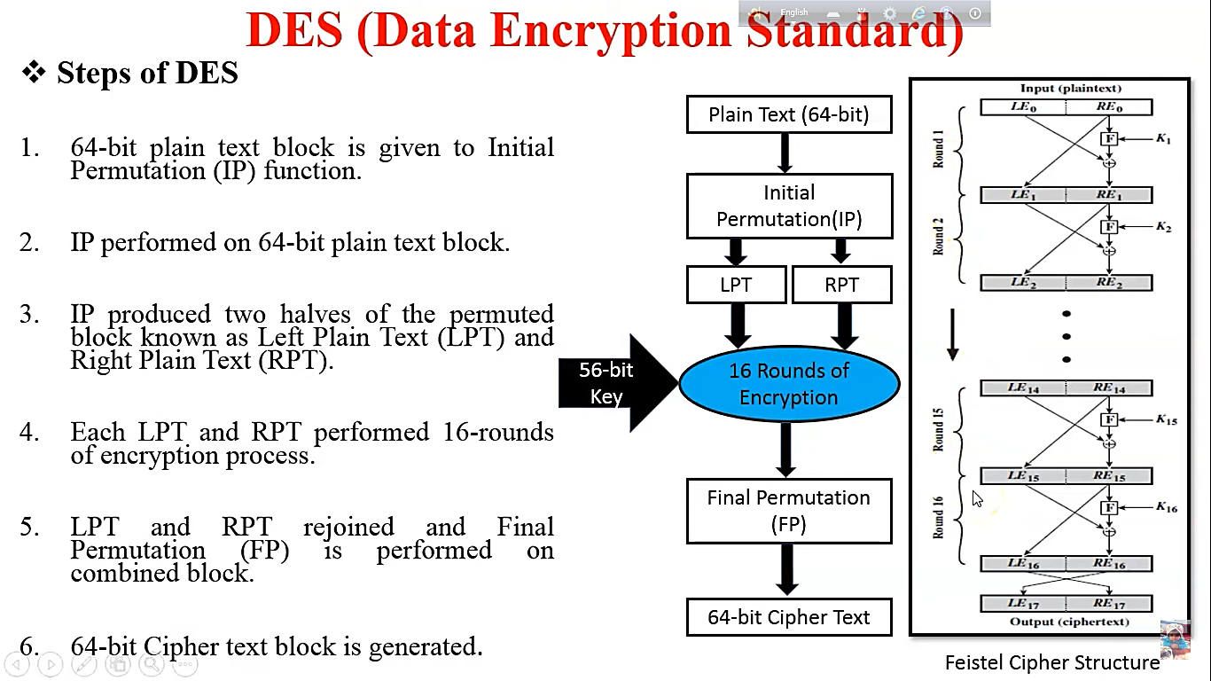
Data Encryption Standard

Slide 26
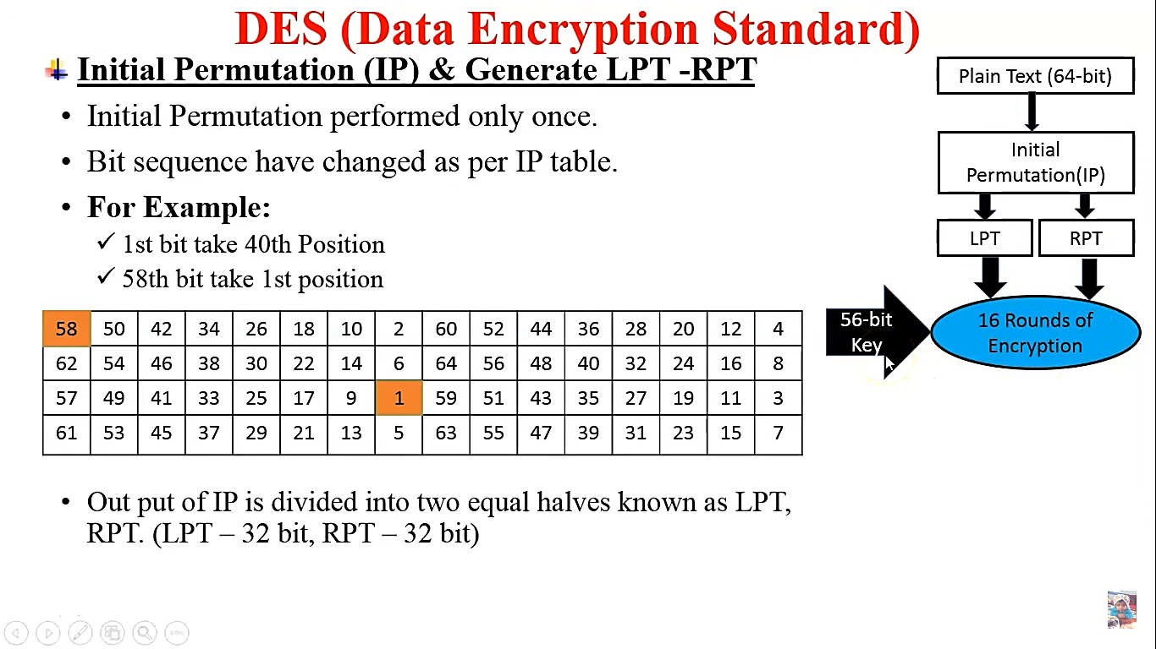
Data Encryption Standard

Slide 27
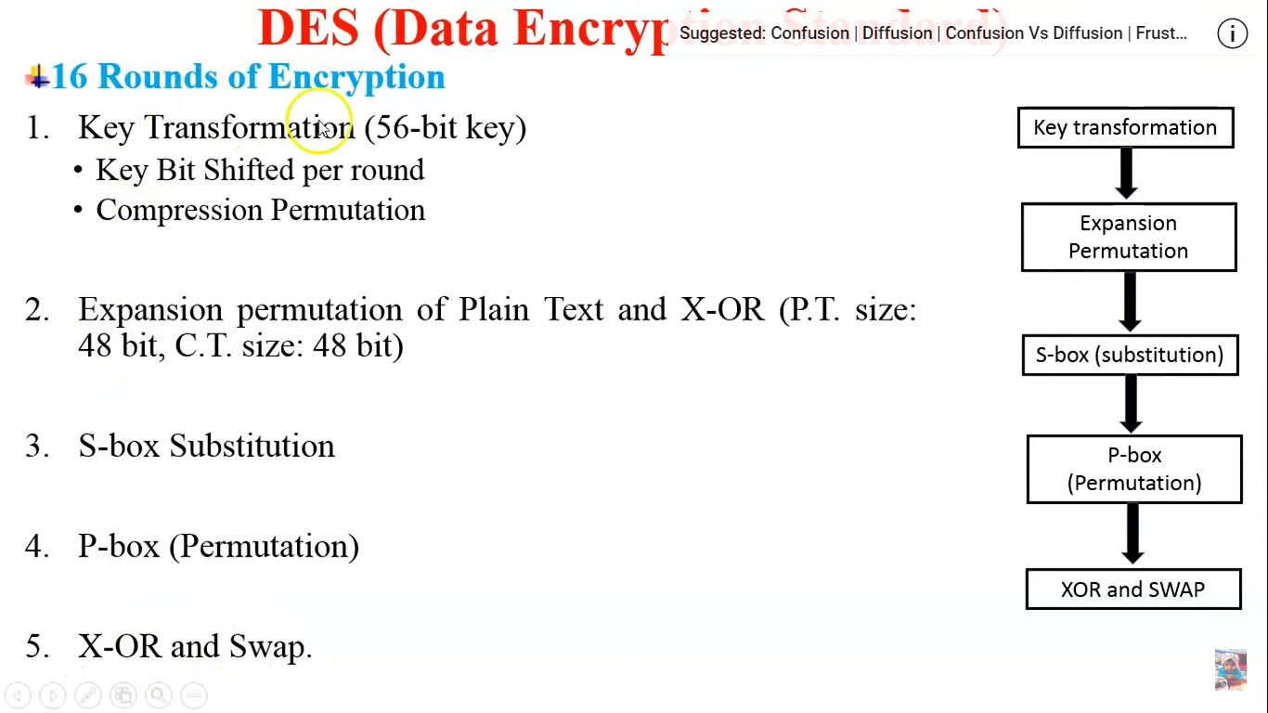
Data Encryption Standard

Slide 28
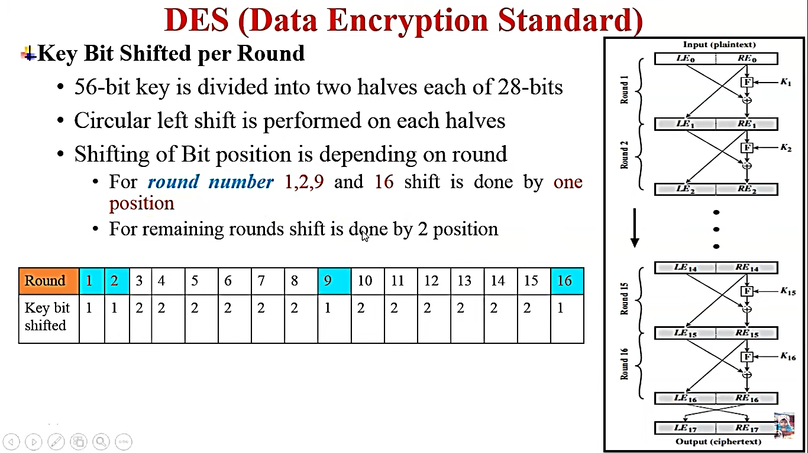
Data Encryption Standard

Slide 29
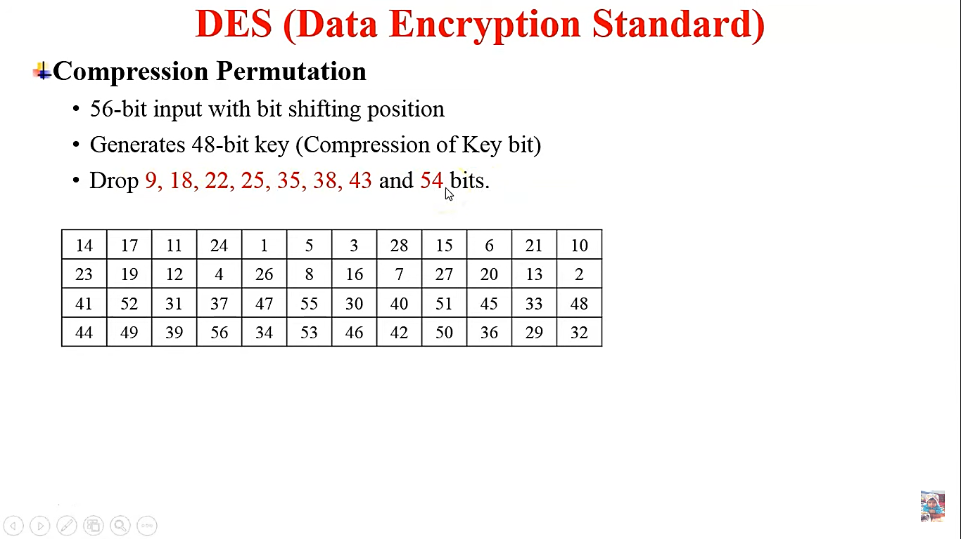
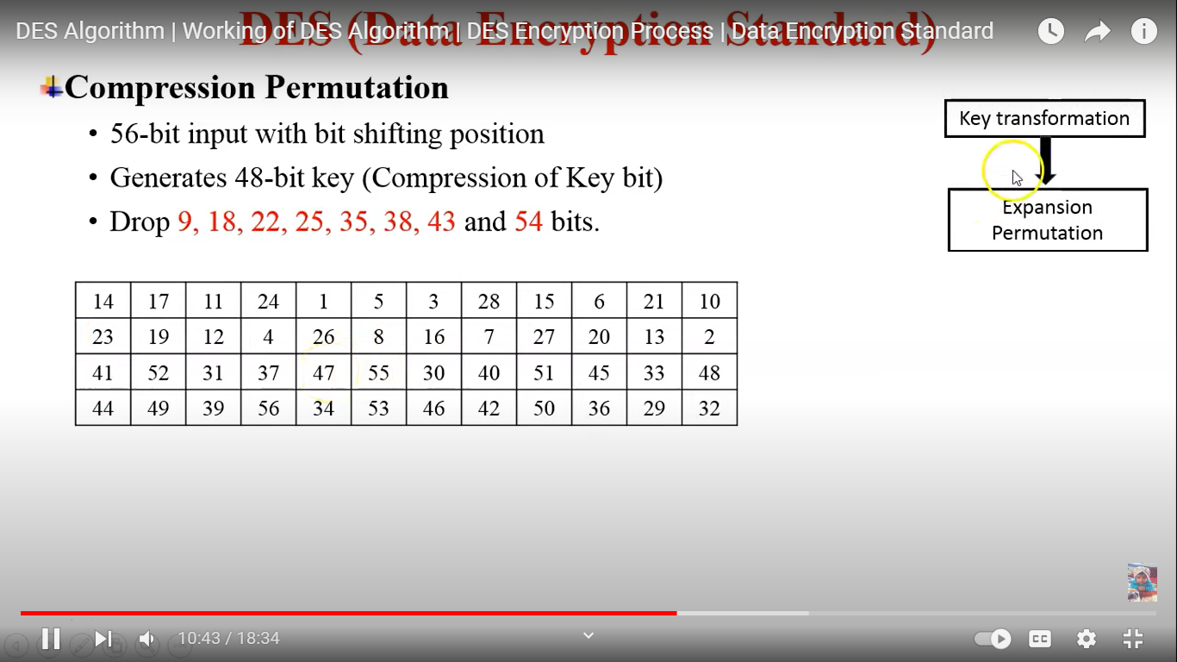
Data Encryption Standard

Slide 30
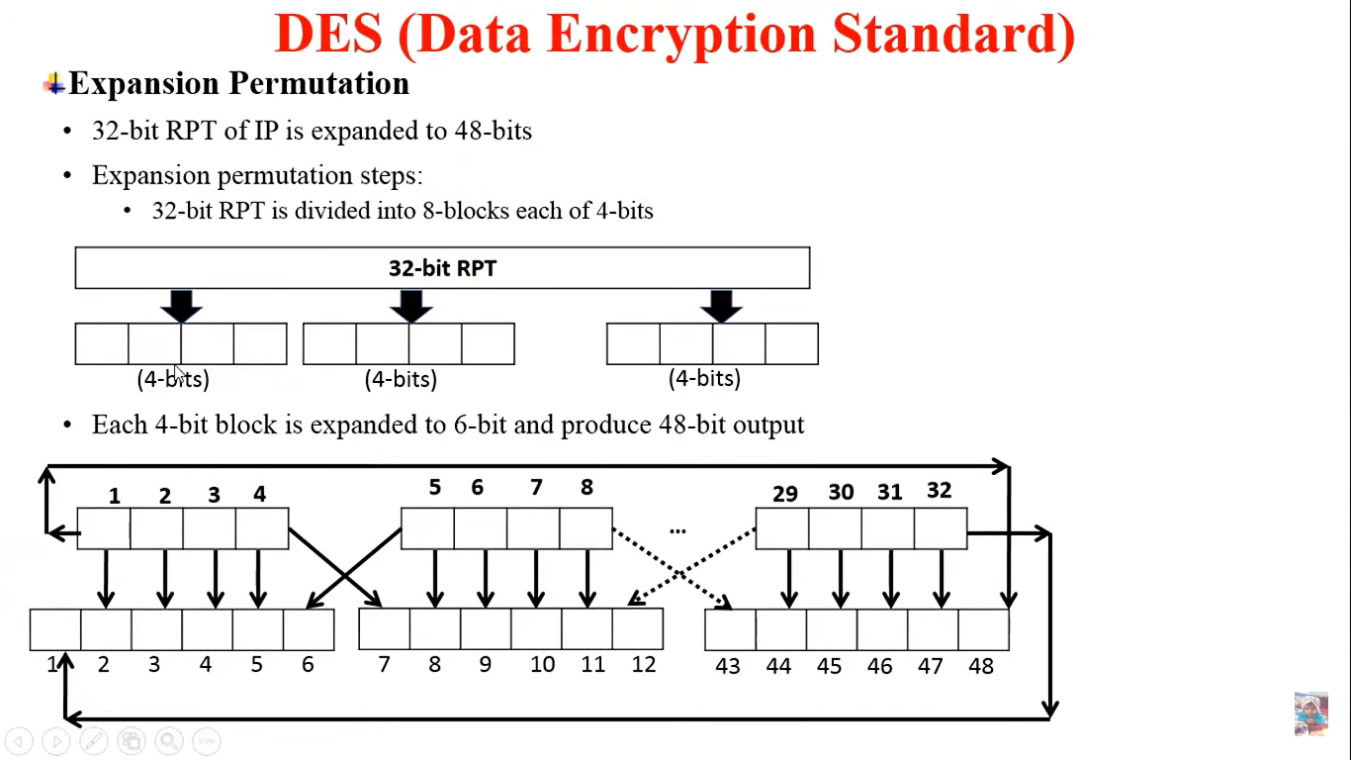
Data Encryption Standard

Slide 31
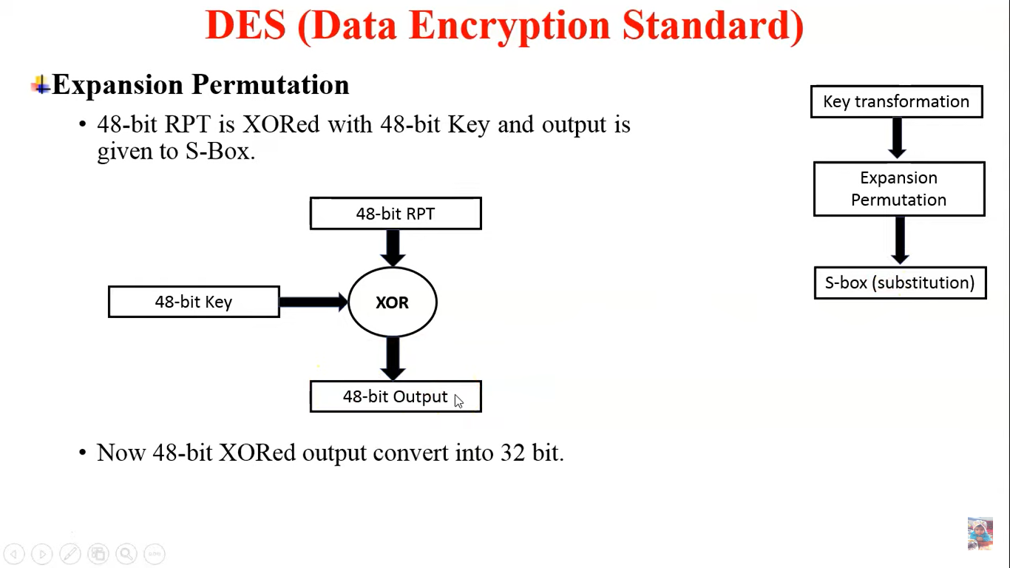
Data Encryption Standard

Slide 32
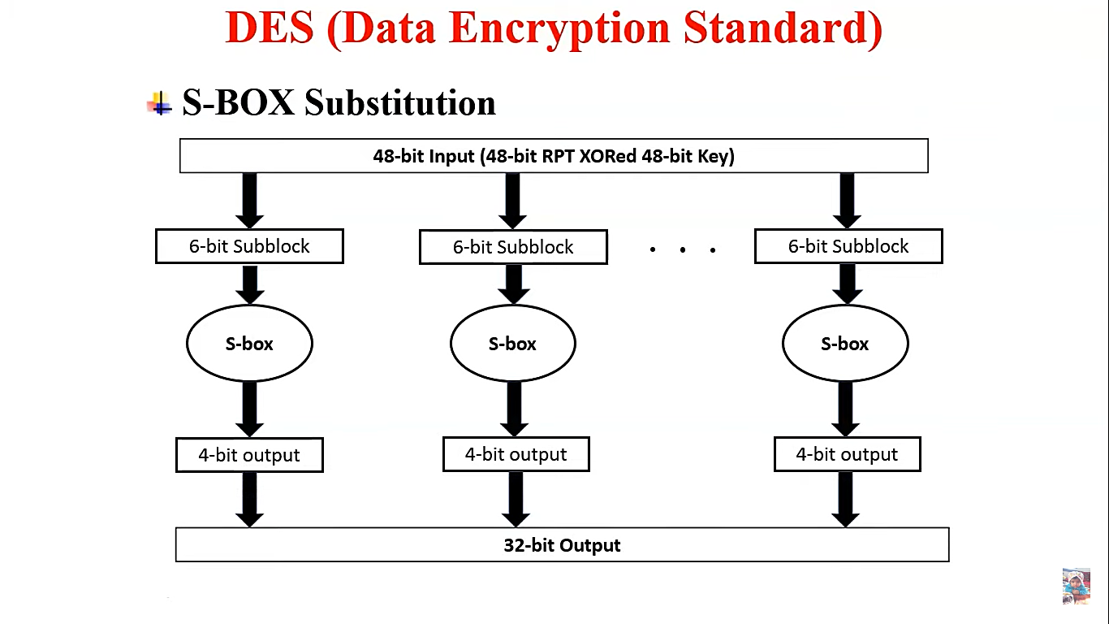
Data Encryption Standard

Slide 33
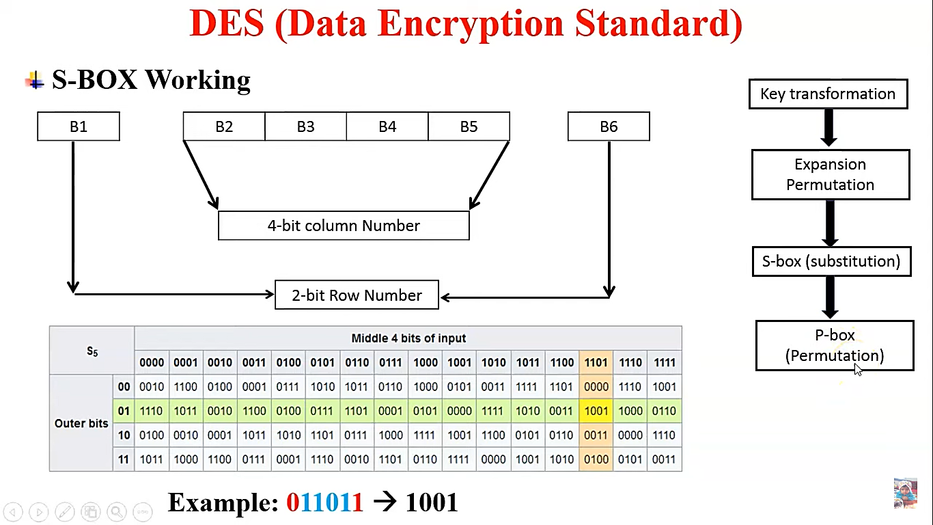
Data Encryption Standard

Slide 34
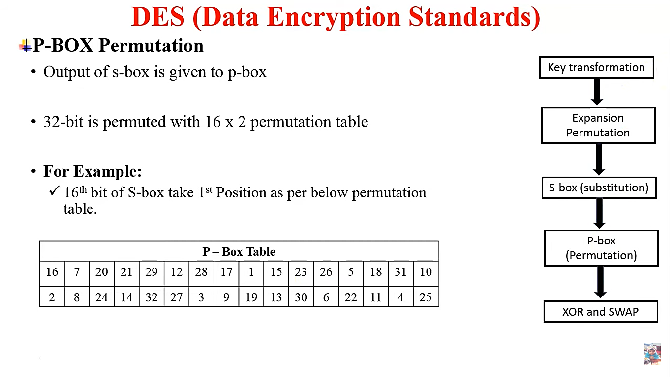
Data Encryption Standard

Slide 35
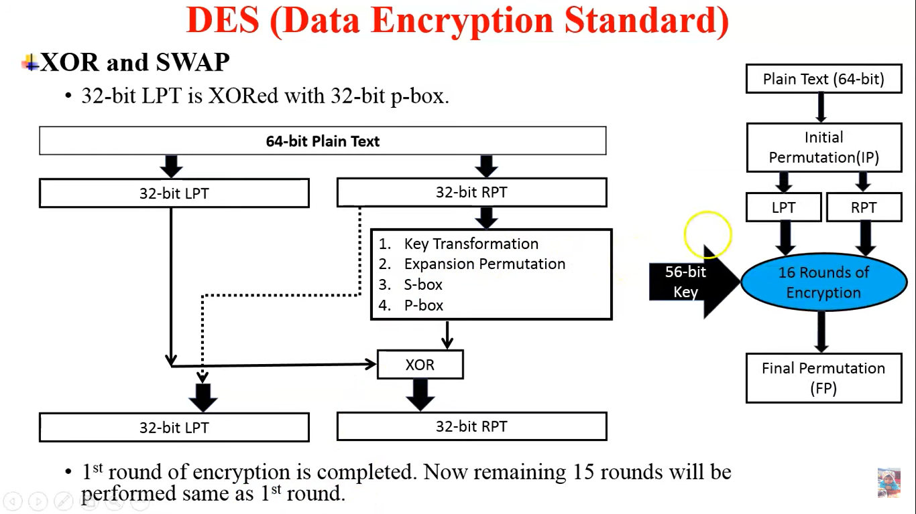
Data Encryption Standard

Slide 36
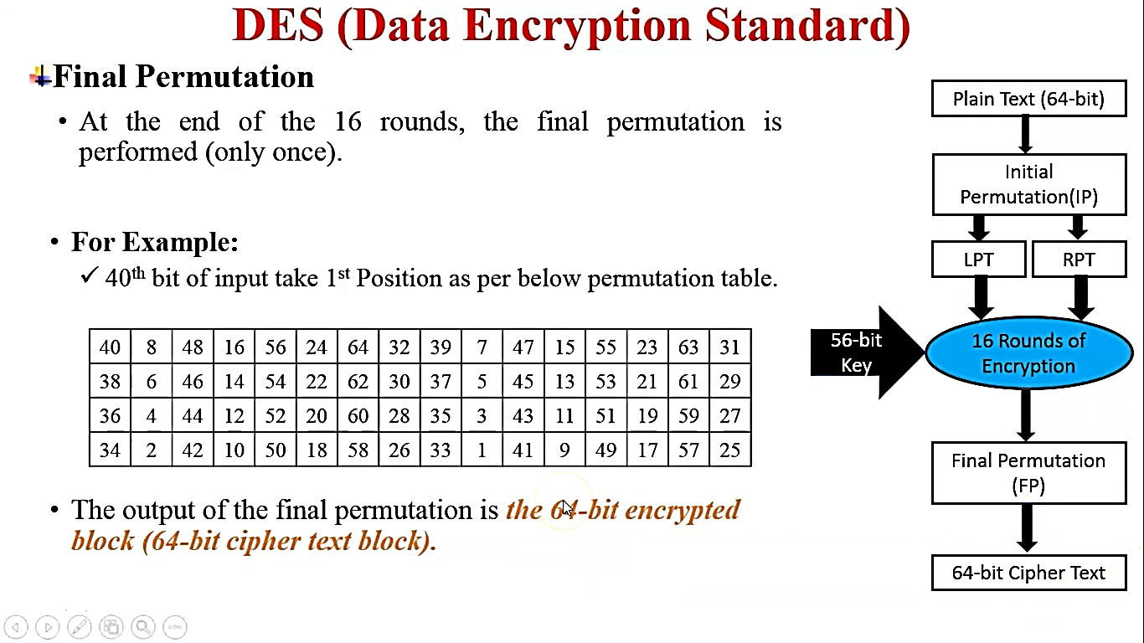
Data Encryption Standard

